Slide 1
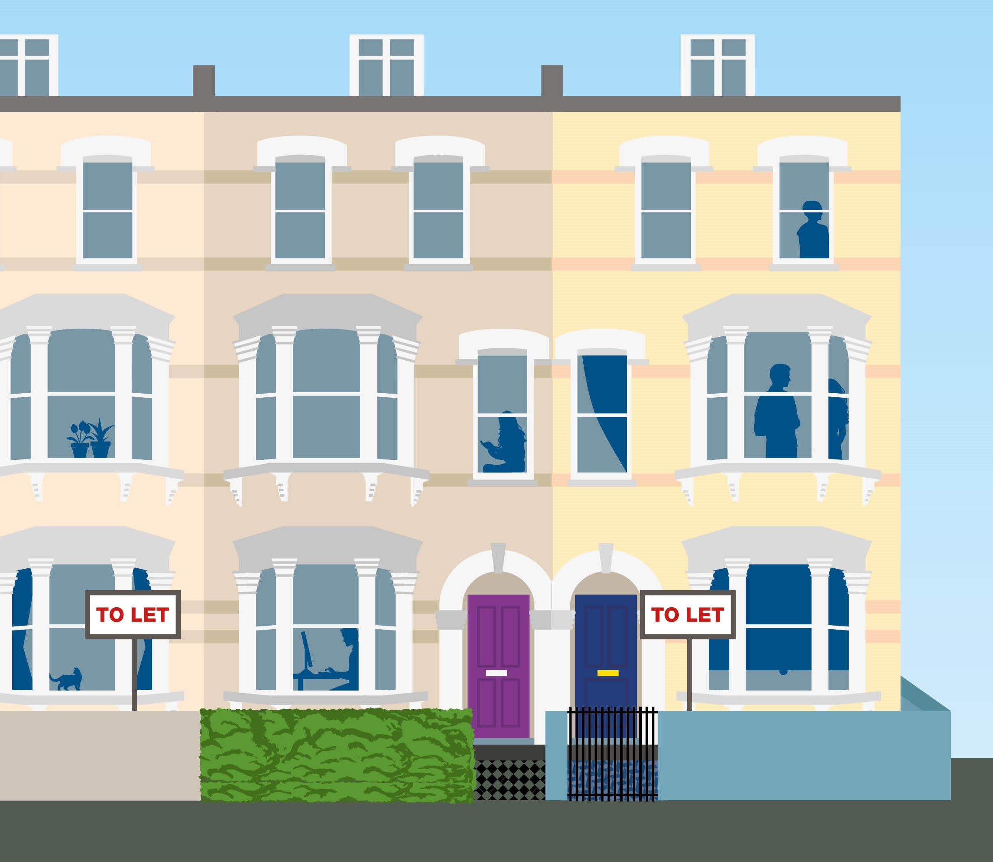
Tenant support
Darren Wilsher
Beverleigh Lawrence

Slide 2
Supporting tenants
Disrepair and poor management
Houses in Multiple Occupation Licensing
Support with rent
Eviction
Harassment

Slide 3
Private Sector Housing Service
Camden – 33% of households (32,186) in private rented sector (London 25%)​
Improve standards within the private rented sector – statutory duty under Housing Act 2004​
Disrepair e.g. roof leaks, faulty heating systems, no hot water, damp and mould, electrical hazards (could mention HHSRS) etc.
Other hazards e.g. excess cold, risk of falling, inadequate security, fire safety etc.
Licensing of houses in multiple occupation (HMOs)

Slide 4
Houses in Multiple Occupation
What is a HMO?
Property where three or more people forming two or more households share amenities (bathroom, kitchen, toilet)
All licensed HMOs inspected (first application and on renewal)
Council’s HMO standards apply to HMOs
Management regulations and HHSRS also apply to HMOs
Licence issued (available on register) with any works needed
One year licence issued where serious concerns
Actively seek out unlicensed HMOs
Compliance inspections carried out
Report unlicensed HMOs to hmolicensing@camden.gov.uk

Slide 5
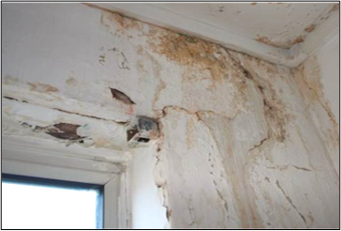
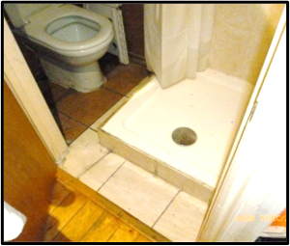
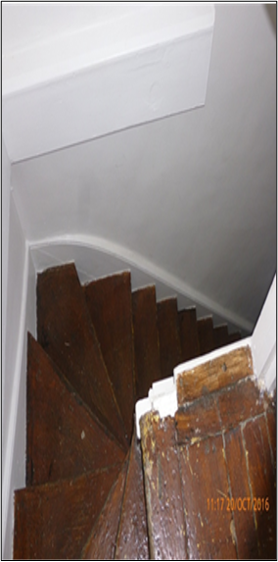
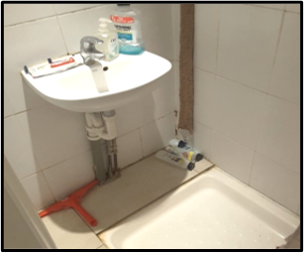
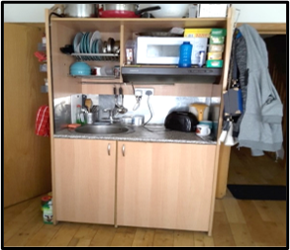
Why we enforce and licence

Slide 6
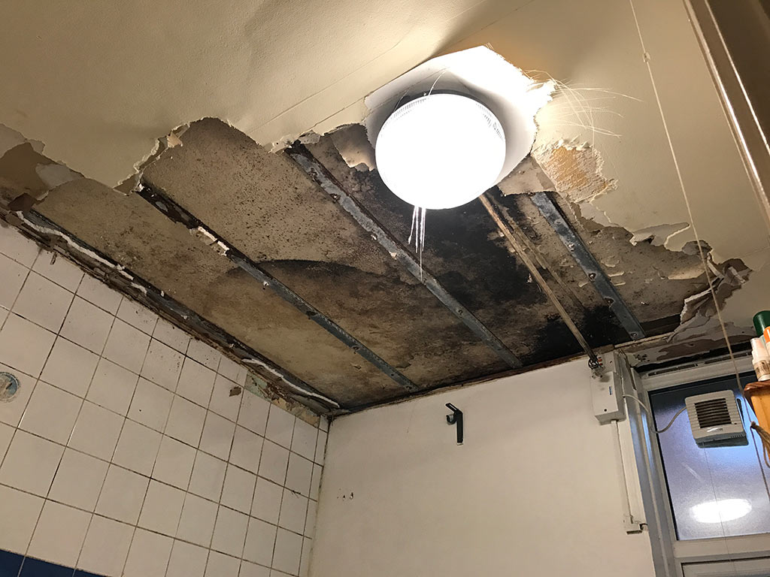
What’s the problem?
The majority of landlords will take reports of disrepair seriously from their tenants.
Unfortunately, there will be some that fail to take action
Camden receives over 700 complaints a year from tenants regarding disrepair
Notes:
Good news is that most landlords will respond to disrepair issues. Unfortunately there are always a small percentage that are slow to respond or just plainly ignore their tenants.
700 is severely undercounting the situation, with many tenants in the PRS not aware that local authorities can support them

Slide 7
Who’s responsible?
Your landlord will be responsible for most repairs:
However, check your contract for extra responsibilities
Electrical wiring | Structure and building exterior
Gas appliances | Baths, sinks, toilets and drains
Fire safety | Damage to decorations
Common areas
Notes:
Important – when talking about landlord please assume we are also cover managing agents that may have been appointed by the owner to respond to a deal with repairs.
Your landlord will be responsible for most repairs.
Electrical safety – New regulations came into force last year requiring electrical installations are checked every 5 years. Copy of report to tenant and any urgent repairs completed within 28 days
All gas appliances should have an annual check, again landlord should give you a copy at the commencement of your tenancy and every time it’s completed
Fire safety – make sure any equipment installed is working, smoke and carbon monoxide alarms. CO alarms where solid fuel fires or stoves. All rented accommodation should have some form of smoke detector installed. Any upholstered furniture provided by your landlord, such as sofas, cushions and mattresses must have a label to show it meets fire safety standards. All new and second hand furniture since 1950.
Common parts – entrance hall and stairways
Structure – walls (rising damp), floors, roof and windows.
IMPORTANT – do check your tenancy agreement (Ideally before signing) whether you have been delegated any repairing responsibilities.

Slide 8
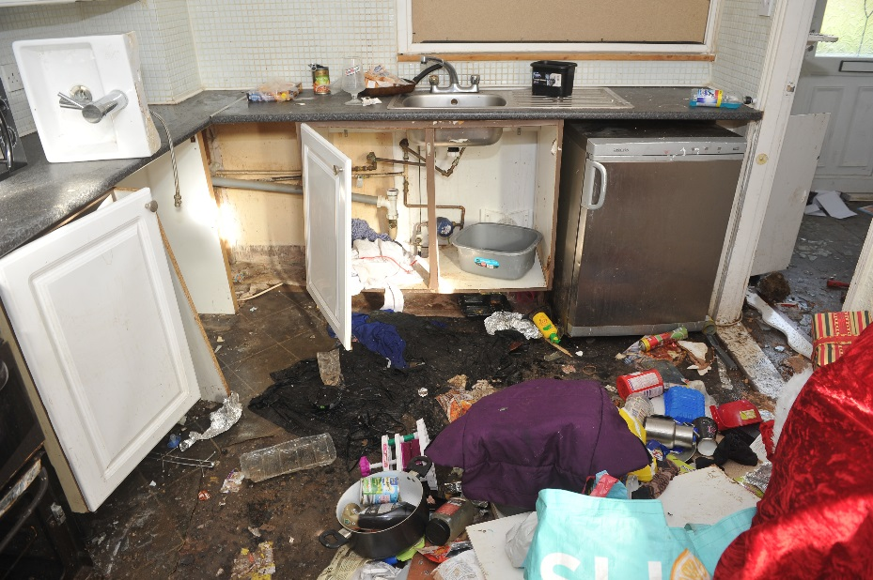
Your responsibilities
You must use your home in a ‘tenant like manner’:
Minor maintenance (lightbulbs, smoke alarm batteries)
Safety checks on electrical equipment you own
Keeping you home reasonably clean
Fixing appliances and furniture you own
Any damage caused by you, your family or guests
Allowing access for repairs
Notes:
You’re not responsible for general wear and tear to the property through normal use :
Carpets
Loose door handles
Peeling paint / wallpaper
Repair any damage you’re responsible for before you leave as your landlord could withhold tenancy deposit to cover costs.
Allowing access
at reasonable times
24 hours written notice
If not convenient you can suggest as alternative time

Slide 9
You’ve got a problem Do’s and don’ts
Do report to your landlord as soon as possible
If urgent report by phone first
Do follow up in writing (letter, email or text):
What repair issue is
If phone call first – when reported and what landlord said they would do
Ask landlord for timescale for repair to be completed
Tell landlord you will follow up if no progress
Do not stop paying your rent
Notes:
Whenever contacting your landlord remember to:
Takes notes of phone conversation (with dates and times)
Keep copies of text and emails – you may need copies of these if landlord fails to carry out repairs.
You should also keep records of when your landlord (or contractors) visit your home
What’s urgent – broken boiler, defective toilet, no running water or electricity supply
Always try to get a timescale from your landlord and tell them you will follow up within 14 days if no progress
Keep paying your rent:
You do not have automatic right to stop paying rent even if:
Your health is at risk
Boiler or toilet are broken
Repairs taking too long
Your landlord can take steps to evict you for withholding your rent.
You could ask for a rent reduction if your everyday living has been disrupted during repair work because of the disrepair. Not automatic, but you can negotiate.

Slide 10
What if no response?
Send another email/text to your landlord
When reported previously
State impact on your physical or mental heath
Give reasonable time period for landlord to respond
You may want to mention you will refer to local council if no response

Slide 11
Still no response!
Contact the council
hmolicensing@camden.gov.uk
www.camden.gov.uk/web/private-renters-in-camden/get-help
020 7974 4444
Can take action using various legislation
Primary legislation - Housing Act 2004
Housing Health and Safety Rating System (HHSRS)
Public Health Acts – blocked drains, WC
Prevention of Damage by Pests Act 1949
Environmental Protection Act 1990

Slide 12
Camden Private Renters website
Wide range of advice and guidance for tenants.
www.camden.gov.uk/web/private-renters-in-camden

Slide 13
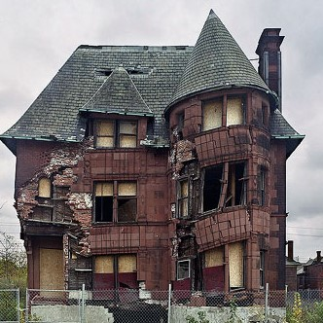
Take your own action
Homes (Fitness for Human Habitation) Act 2018
Notes:
Landlord must make sure your rental property is fit,
Home too cold
HHSRS elements
Will need to explain to court why problems are so bad that it makes it not fit to live in.
You might still be better contacting your council as they may be able to protect you against being evicted because you complained.
Still need to tell landlord about the issue to give them opportunity to fix problem.
Apply to court – you will need to gather your evidence photos, letters emails etc
At court, will hear evidence from you and the landlord.
IF YOU FAIL YOU CAN STILL CONTACT THE COUNCIL

